Slide 1
COM6230 Implementing cyber security
Security Models

Slide 2
Outline
Security Models
High level: to understand what is going on
Theoretical: to evaluate.
General issues

Slide 3
Introduction
So what will we need to cover?
We need to get an overview...
? What model of security do we have
Castle:- locking down servers
Well-Fargo/ Security Core : Transferring data.
In an IoT world is this changing.
Notes:
i was reading about decided today which sort of changes in western society is actually operating differently an interesting this is a sociologist tell us that western culture is becoming more tribal , so we break up it's a little units of interest in this or interest in in something else , and the argument goes falling in the book was about the implications that had for how we should operate in such a society.

Slide 4
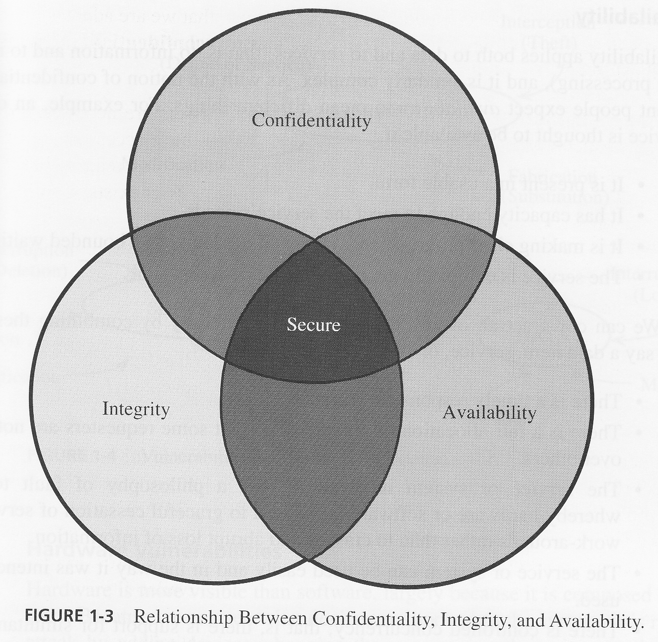
Language
We need to ensure:
Confidentiality
Integrity
Availability
Known as the CIA triad, security is achieved if you have all three
We have trust in the systems if all 3 are not violated

Slide 5
Language
Confidentiality is focused on the information
making sure the only thing as you can see who have a right to say the information conceded.
Access control, without it you do not have security.
"is the property, that information is not made available or disclosed to unauthorized individuals, entities, or processes" (Except ISO27000)
What is the difference between Confidentiality and Privacy?

Slide 6
Language
Availability is focusing on users
the idea that everybody who needs to see the information can.
Perverting disruptions caused by hardware/software failures, power cuts/brown outs
Could also mean preventing denial od service attacks
Not exactly opposite to confidentiality

Slide 7
Language
Integrity, the data has not been distributed; it is accurate and complete over the data’s lifecycle.
Two more concepts that have been added since the original three.
Authenticity:
The assurance that transaction is it really from who they say it is from, is it genuine, uses digital signatures
Non-repudiation
Law focused, it is the obligations of a contract; to fulfil that contract. So you cannot say you did not receive or did not send the transaction. Technology helps but it is Law based

Slide 8
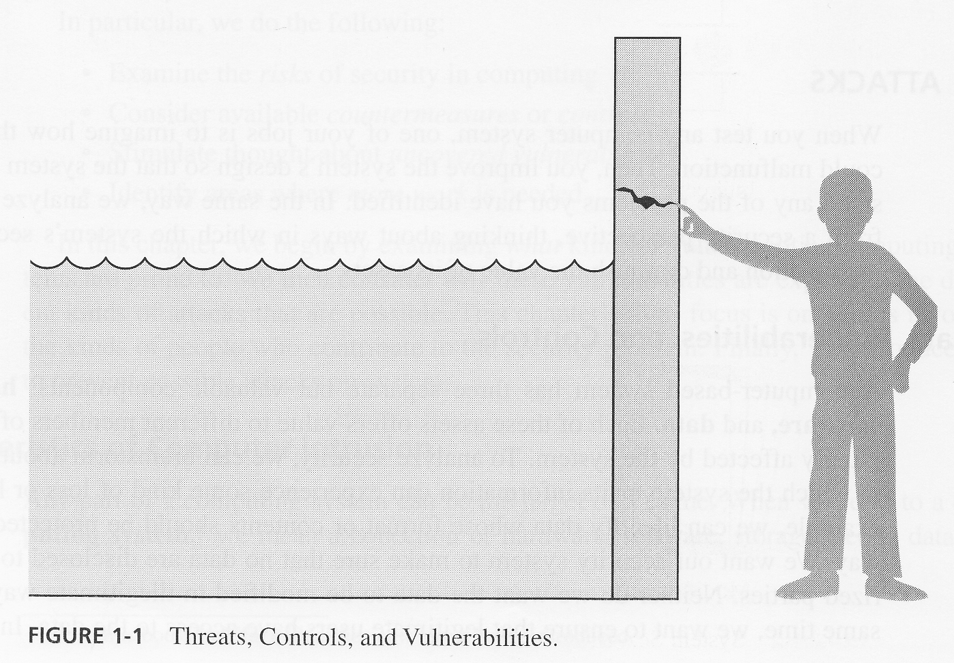
Language
There are:
Threats
Vulnerabilities
Controls
Metaphor: chain
Vulnerability=hole
Threat = water
Control= figure
Notes:
One little hole and whole lot floods. The boy acted and waited to get help.
T=Water
C= figure
V=hole
Just a reminder in terms of the language that you will see used in the world of security:
you have the threat what it is that might happen
the vulnerability where we week
the control is how do we handle the weakness to make sure that the threat doesn't become a reality ,
We might want to look as a wide range of things are looking in the field of security
A metaphor: if you've got something importance hanging on the end of a chain the security is entirely dependent on the strength of every single link. If one link is weak anyone link is week, then you endanger the safety of the thing on the end of the chain. So even if you've got all of us tools in the world if you got one thing this weak you all care as we saw last time you care about the people in the process
Example mission impossible film they needed to break into a factory, must have been a sense of the manufacturing toys or something but of course that's what mission impossible and so tom cruise and someone else of breaking into this country crawling around the ventilation ducts and so on get to where the super computer is and really important information and they did drop down on a wire so he doesn't touch the floor and hacks in to the computer and gets all the date he wants and then up a through the ducts and wait and do you think , it might be brilliant cinema produced total rubbish he would never tell you that if you are hacking into a computer if you'd probably tries to make sure you never even set foot on the premises but because that's the ways is dodge if you're going to hack in you don't leave a trail. if he if you ended up so you did have to actually hacking at the very least he'd walk the building dressed as a the clean or something you got the security guard and you'd pay him enough money ,

Slide 9
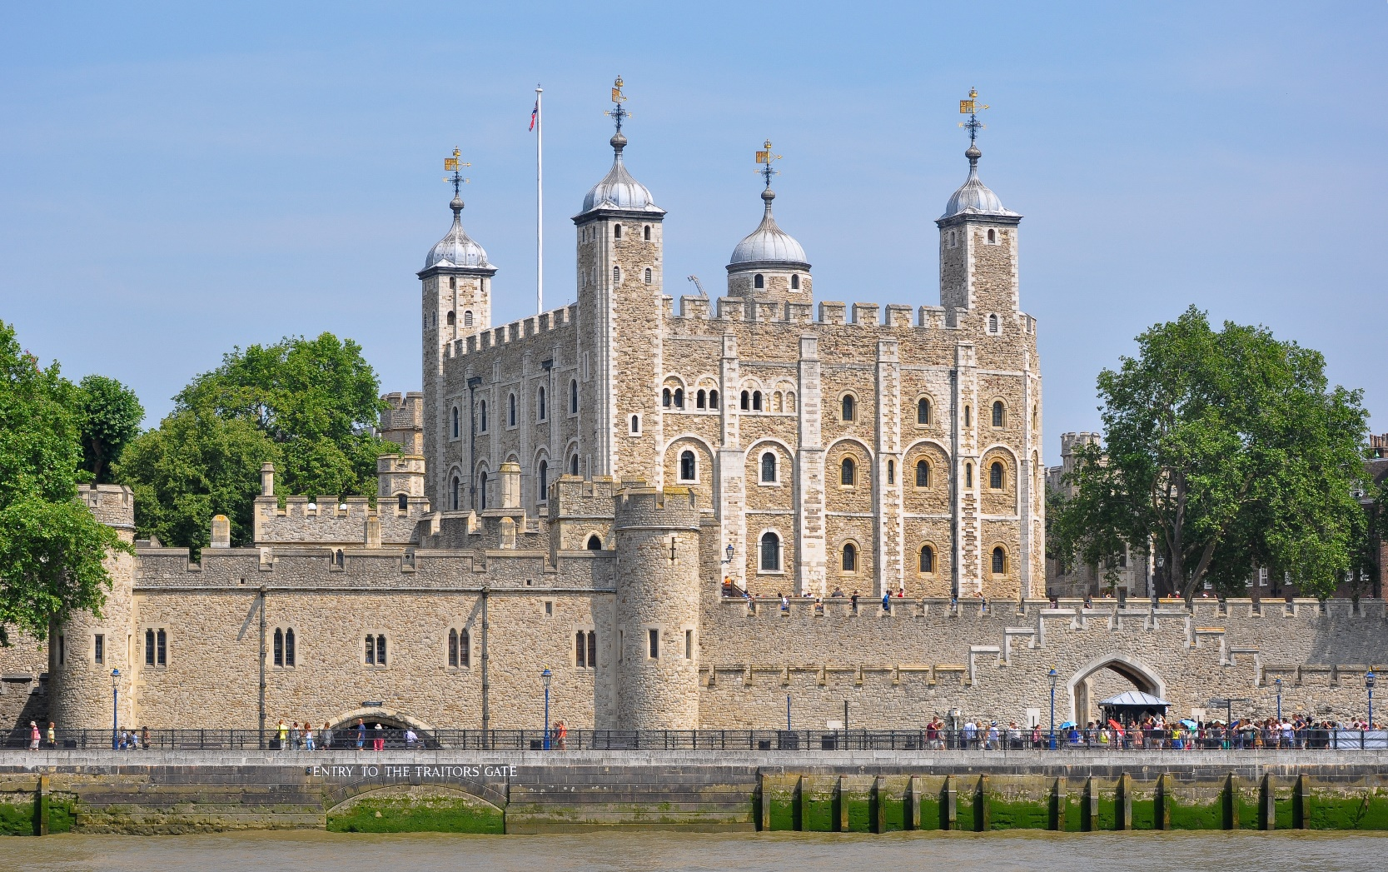
Castle Defence
Notes:
Massive square tower with four corner turrets
Built in the times of William the Conqueror and William Rufus
Extremely thick walls
Internally divided into two halves
Incorporated rooms for storage and living quarters
Also has a built in chapel
Although square keeps were still being built, it became clear that the old design had several problems: -
Easy to undermine at corners
Corners had defensive blind spots
To overcome these problems the castle designers began to build multi-sides and round keeps. Orford Castle is a very good example of a many sided keep and is still in very good condition.

Slide 10
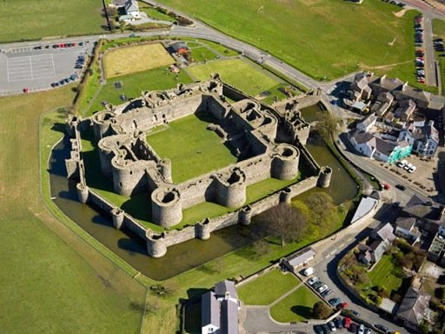
Castle Defence

Slide 11
Static Security Models
We are trying to protect our treasure
data or anything else possibly money, this also includes your staff, some of interest to me.
To protect my treasure I am going put a efend around it.
Assume money for a minute I am going to dig a hole and thorough it in. cover it in concrete and make it 100% secure
One small problem I cannot get at it either, so yes it confidential and integral but not available

Slide 12
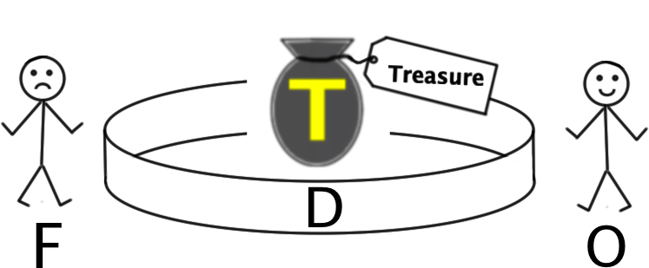
A Static Security Model
We have:
T – some “treasure”
O – the owner
F – a foe
D – a defence

Slide 13
Static Models
I now need availability to my Treasure.
So I have to make an access, if you like I have created a breach in the security.
So I now need a guard otherwise my foe can get in.
Guard: user name password, etc
Following a procedure like who goes there (access policy, access control lists).
So the Foe has to either convince the guard that they are friend or find another way of breaking in
So you will have to follow a code of ethic that appliers to security. This applies to ethical hackers.
However the Foe does not follow these codes.
Kill the guard, social engeineering

Slide 14
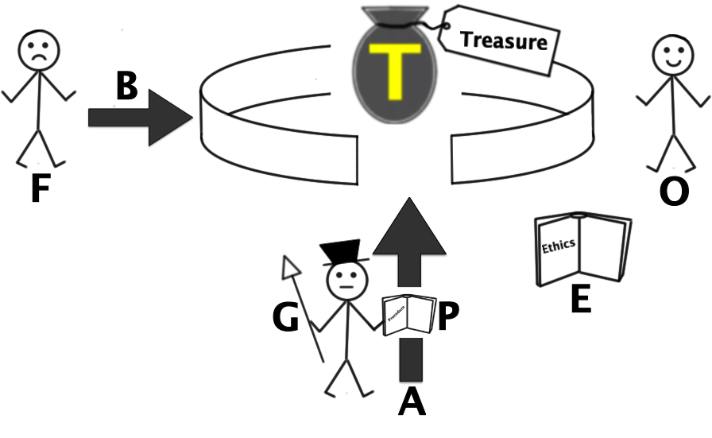
A Static Security Model
We also need:
A – Access
G – a Guard following
P – a Procedure
The Foe may try to:
B – Break the defence
There may be a:
E – code of Ethics
What are the common vulnerabilities here for a server?

Slide 15
Static Security Models
A firewall is often our boundary gateway (Castle way).
The Foe is always looking at ways to breach the castle walls. But :
We leave the windows open by not closing unused ports
We do not change the default passwords on the firewall, routers and switches, we leave the keys in the door.
This is what is meant by secure configuration.
Regularly you should always run a port scanner yourself.
Look at the logs to see who is scanning your ports and from where (persistent offenders)
Policy and Audit default passwords

Slide 16
Static Security Models
We now have a number of hardware and software components in our security system.
Vulnerabilities are often caused by human error.
Hence manufactures will let you know when they have found these and issue patches to plug the vulnerability in software
Our job is to have a process of patch management to make sure that the patches are up to date- why?
Malware can come into our system through user error.
So again we need to have Malware protection that is up to date

Slide 17
Static Security Models
In our secure system we are holding sensitives information.
Not everyone who has access to the system should be able to see it.
System programmers for example seeing your medical record, company finical information, minutes of meetings, etc.
Also when we transmit he information from one person to another we really do not always want everyone to be about to know what the information is about.
Answer is that we encrypt the information.
Only the intended authorised user can understand the massage

Slide 18
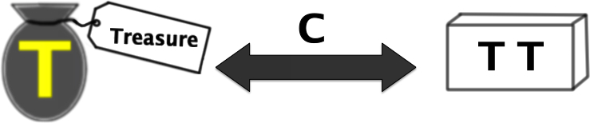
A Static Security Model
The Treasure could be:
C – Converted into a
T' – Transformed state
(encrypt)
Notes:
Very often in IT we will encrypted something before we store it.

Slide 19
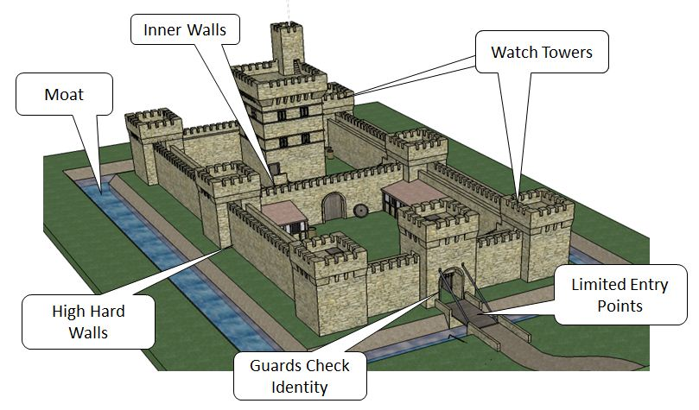
Static Security Model: layered defence
Similar to a real castle, we want to layer our defences, inter-outer walls, moats etc.

Slide 20
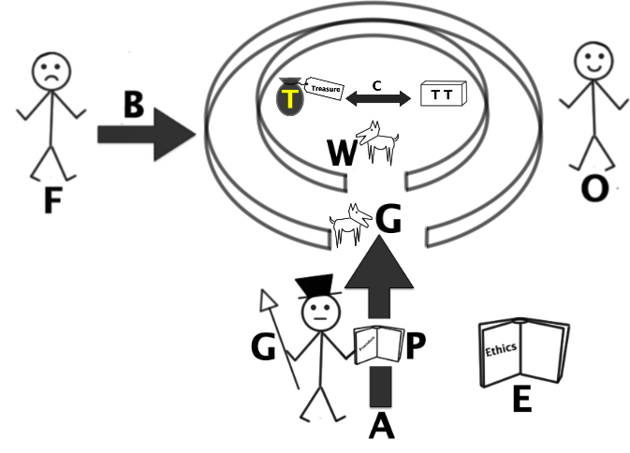
A Static Security Model
There might also be:
A layered defence
A guard dog
A watchdog

Slide 21
Static Security Models
In security we also layer our defences.
We will partition areas with firewalls
Corporate Network, from HR and accenting, from DMZ
Our intrusion detection systems is our guard and watch dogs
It can simply be set to given an alarm if an event happens
It could monitor events and alert if behaviour is abnormal

Slide 22
Static Security Models
We have now created a hole in our castle wall to let people in, so we now need to control the access.
Access control
Authorization means that person has permission to have access to the information
We need policies: Do we disable accounts, who has authorised new accounts, how often are these audited.
Left over accounts is he first entry points for hackers and ghosts

Slide 23
Passing information
Passing information between parties is the key to commerce
Every thing from contrast on deals, secret designs, legal agreements etc.
It is the means by which decisions are made
If I can interrupted, interfere, or change the information, I can make the recipient act differently on that information.
Rothschild had an army of couriers and agents gathering information.
Notes:
In 1815 he new the British had won at Waterloo before any one else, so he spread a rumours that they had lost. He bought all the depressed stock, and when the official news came in that the British had won he made another fortune

Slide 24
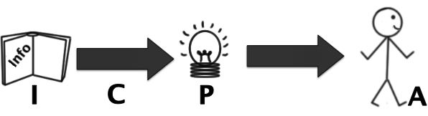
An Information-Passing Security Model
We have:
I – some Information
C – Communicated
P – and Processed
A – leading to a resultant Action
Foe: Take action on the information. interrupted and hack the information.
However if I can interfere with the process (mind games) I can make the recipient act differently on that information.

Slide 25
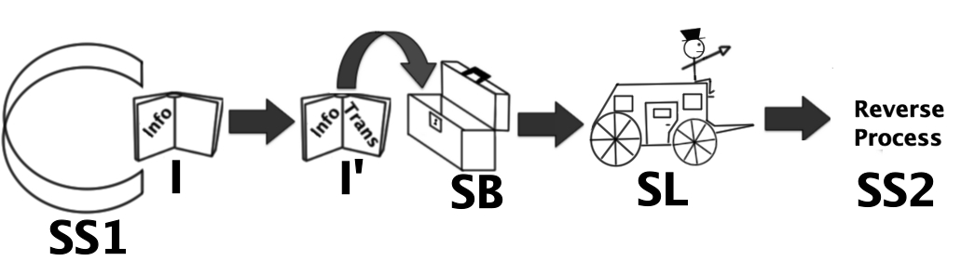
Another Information-Passing Security Model
We have:
SS1/2 – secure storage
SB – “Strong Box”
SL – Secure Link
I – some Information
I' – transformed (e.g. encoded)‏
Notes:
Communications, moving from one area of storage to another area of storage.
Locking it up in some secure server, sets up secure linkage through the stage coach

Slide 26
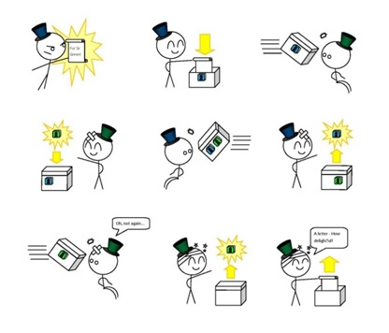
How to pass information securely
Notes:
In 1815 he new the British had won at Waterloo before any one else, so he spread a rumours that they had lost. He bought all the depressed stock, and when the official news came in that the British had won he made another fortune

Slide 27
Diffie–Hellman key exchange
Actually developed by GCHQ in 1975 but kept secret until 2002.
Allows two parties that have to jointly establish a shared secret key over an non-secure communications channel.
This key can then be used to encrypt subsequent communications using a symmetric key cipher.

Slide 28
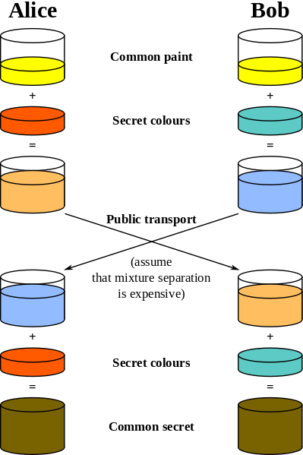
Diffie–Hellman key exchange
Note the common colour (yellow) is the shared.
This must be agrees by both parties first.
Brown is now the key they can use to encrypt future messages.
Source http://en.wikipedia.org/wiki/Diffie%E2%80%93Hellman_key_exchange

Slide 29
An Information-Passing Security Model
Note that attack may come in terms of:
Corruption of original information
Disruption of communication
Corruption of information in transit
Interference with processing of information
Nullification of action

Slide 30
Castle Defence: in a changing world
The castle defence has been a good model for a while.
However now people bring their own devices into work, we have the IoT providing information but from outside our walls.
Hence research is looking at new ways to handle this security.

Slide 31
Summary
Like a medieval castle we build defences around our sensitive information.
We can use this analogy to explain what we are trying to do to no technical peoples.
As an analogy it has worked well, however the landscape is changing and new models are required.

Slide 32
Questions
Explain what is meant by a
Static security model (4 Marks)
Information passing model (4 marks)
Formal model (8 marks)

